Slide 1

Microeconomics

Slide 2
What is Microeconomics?

Slide 3
Basic Concepts of Microeconomics
Production theory: This is the study of production — or the process of converting inputs into outputs. Producers seek to choose the combination of inputs and methods of combining them that will minimize cost in order to maximize their profits.
Utility theory: Analogous to production theory, consumers will choose to purchase and consume a combination of goods that will maximize their happiness or “utility”, subject to the constraint of how much income they have available to spend.
Price theory: Production theory and utility theory interact to produce the theory of supply and demand, which determine prices in a competitive market. In a perfectly competitive market, it concludes that the price demanded by consumers is the same supplied by producers. That results in economic equilibrium.
Industrial organization and market structure: Microeconomists study the many ways that markets can be structured, from perfect competition to monopolies, and the ways that production and prices will develop in these different types of markets.

Slide 4
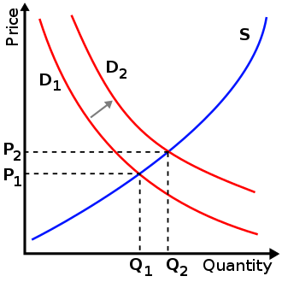
Supply and demand
Supply and demand is an economic model of price determination in a perfectly competitive market. It concludes that in a perfectly competitive market with no externalities, per unit taxes, or price controls, the unit price for a particular good is the price at which the quantity demanded by consumers equals the quantity supplied by producers. This price results in a stable economic equilibrium.
Prices and quantities have been described as the most directly observable attributes of goods produced and exchanged in a market economy. The theory of supply and demand is an organizing principle for explaining how prices coordinate the amounts produced and consumed. In microeconomics, it applies to price and output determination for a market with perfect competition, which includes the condition of no buyers or sellers large enough to have price-setting power.

Slide 5

The Uses of Microeconomics
As a purely normative science, microeconomics does not try to explain what should happen in a market. Instead, microeconomics only explains what to expect if certain conditions change. If a manufacturer raises the prices of cars, microeconomics says consumers will tend to buy fewer than before. If a major copper mine collapses in South America, the price of copper will tend to increase, because supply is restricted. Microeconomics could help an investor see why Apple Inc. stock prices might fall if consumers buy fewer iPhones. Microeconomics could also explain why a higher minimum wage might force The Wendy's Company to hire fewer workers. Microeconomics can address questions like these that might have very broad implications for the economy; however, questions about aggregate economic numbers remain the purview of macroeconomics, such as what might happen to the gross domestic product (GDP) of China in 2020.

